Slide 1


Slide 2
Presented By: Ashwini A. Patil
submission Date:11/07/2022

Slide 3
Acknowledgement:
Primarily I would like to thank God to being able to complete this project with success. Then I would like to express my special thanks of gratitude to my SME,
And I am thankful I am part of flip rob technology of employee, who given me the golden opportunity to do this wonderful project on the given topic which is also help me in doing a lot of research and I came to know about so many new things, I am really thankful to flip robo.
ASWINI A. PATIL
DATE:24/06/2022
Data Science course
Institute: Data trained education
Internship: Flip Robo technology @Bangalore

Slide 4
Abstract
A car price prediction has been a high interest research area, as it requires noticeable effort and knowledge of the field expert. Considerable number of distinct attributes are examined for the reliable and accurate prediction.
To build a model for predicting the price of used cars the applied three machine learning techniques and artificial neural network and linear regression.
Respective performances of different algorithms were then compare to find one that best suits the available data set. The final prediction model was integrated into java application. Furthermore, the model was evaluated using test data and the accuracy of 82% was obtained.

Slide 5
Introduction
From a long time since being a continuous paradigm of transaction of commodities has been into existence. Earlier these transactions were in the from of barter system which later was translated into a monetary system. And with consideration into these, all changes that were brought about the pattern of re-selling items was affected as well. There are two ways in which the re-selling of the item is carried out. One is offline and the other being online. In offline transaction, there is mediator present in between who is very vulnerable to being corrupt and make overly profitable transaction. The second option is online wherein there is a certain platform which lets the user find the price the might get if he goes for selling
Vehicle price prediction especially when the vehicle is used and not coming direct from the factory , in both a critical and important task. With increase in demand for used cars more and more vehicle buyer are finding alternatives of buying new cars.
There is need of accurate price prediction mechanism for the used cars. Prediction techniques of machine learning can be helpful in this regard.
It is common to lease a car in many countries rather then buying a new car.

Slide 6
Motivation
Deciding whether a used car is worth the posted price when you see listings online can be difficult. Several factors, including mileage, make, model, year, etc. can influence the actual worth of a car. From the perspective of a seller, it is also a dilemma to price a used car appropriately. Based on existing data, the aim is to use machine learning algorithms to develop models for predicting used car prices.

Slide 7
Objective
The main aim of this project is to predict the price of used cars using the various Machine Learning (ML) models. This can enable the customers to make decisions based on different inputs or factors namely
To build a supervised machine learning model for forecasting value of a vehicle based on multiple attributes
The system that is being built must be features based i.e. feature wise prediction must be possible.
Providing graphical comparisons to provide a better view.
Predict the price of a car, bike, electric vehicle and hybrid vehicle. This app can predict the price of any vehicle because of the smartly optimized.
• Brand or Type of the car one prefers like Ford, Hyundai
• Model of the car namely Ford Figo, Hyundai Creta
• Location like Delhi, Chennai, Mumbai
• Year of manufacturing like 2020, 2021
• Type of fuel namely Petrol, Diesel
• Price range or Budget
• Type of transmission which the customer prefers like Automatic or Manual
• Mileage

Slide 8
Case Study Description
With the Covid-19 impact in the market, we have seen lot of changes in the car market. Now some cars are in demand hence making them costly and some are not in demand hence cheaper.
One of our clients works with small traders, who sell used cars. With the change in market due to Covid-19 impact, our client is facing problems with their previous car price valuation machine learning models. So, they are looking for new machine learning models from new data. We have to make car price valuation model.
In the dataset, I have scrapped 6000 different kinds used cars data.
The given dataset contains various Brands, Models, Kilometers driven, Manufacturing Year, Number of Owners, Fuel Type of the particular car, and finally the price of the car. These cars are selling in various locations in India. The given dataset includes all types of cars for example- SUV, Sedans, Coupe, etc.

Slide 9
Data Processing
Null Values : The dataset has no null values present in it originally.
Unique values and Value count of each column.
The “Kilometers Driven” column has commas in the data so I removed the commas.
The “No of Owners” column has repetitive entries under 1st owner and First owner as well as 2nd and Second owner. So, I merged these data to 1st and 2nd owner respectively

Slide 10
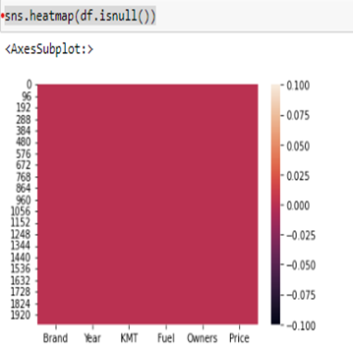
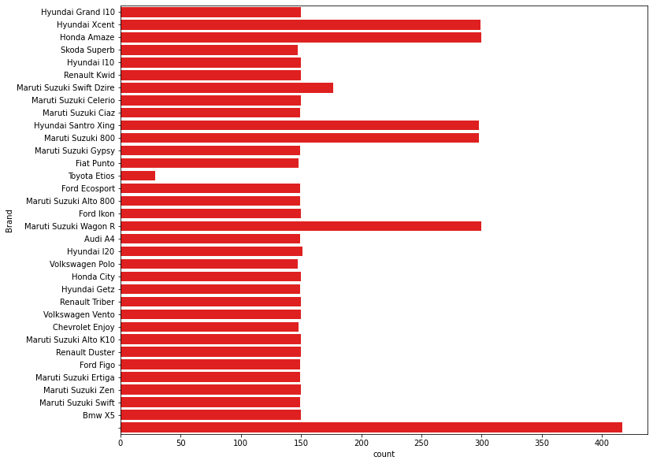
Data Visualisation

Slide 11
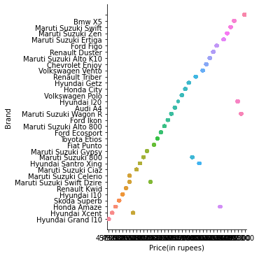
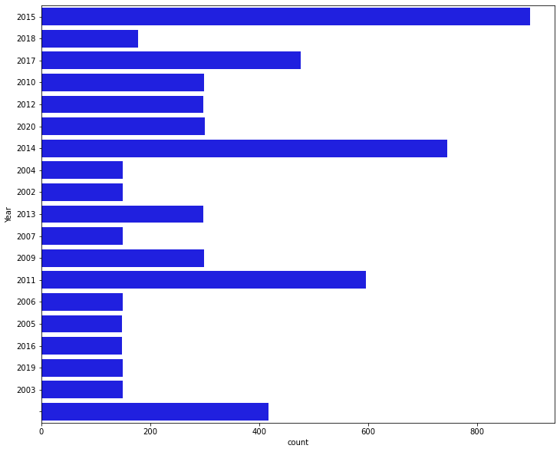
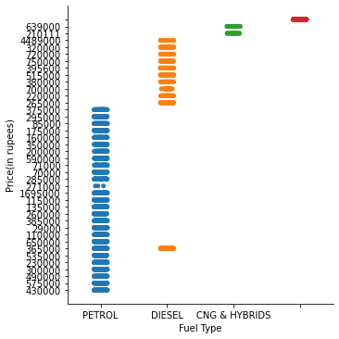

Slide 12
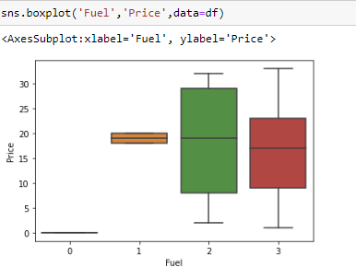
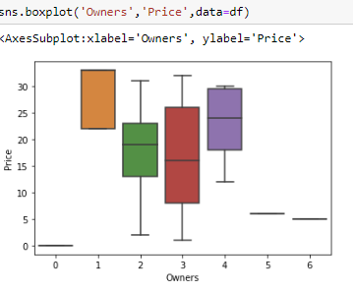
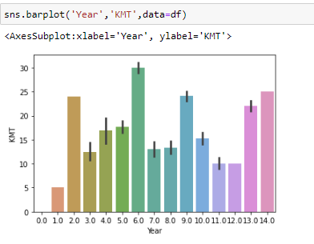
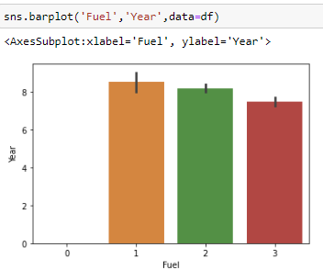

Slide 13
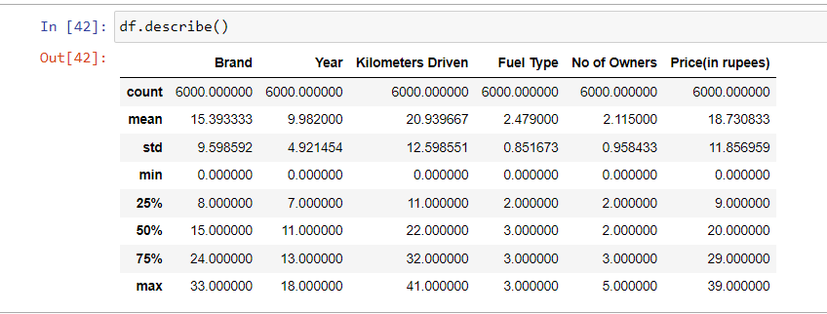
Statistical Summary

Slide 14
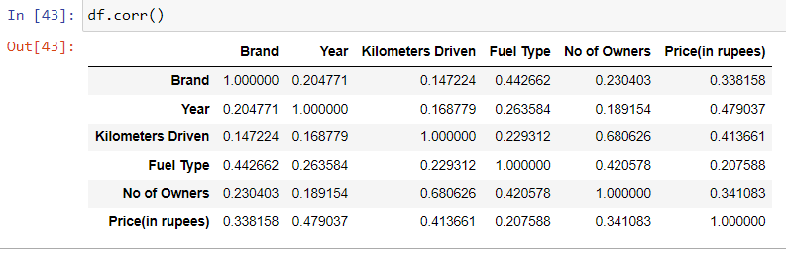
Correlation

Slide 15
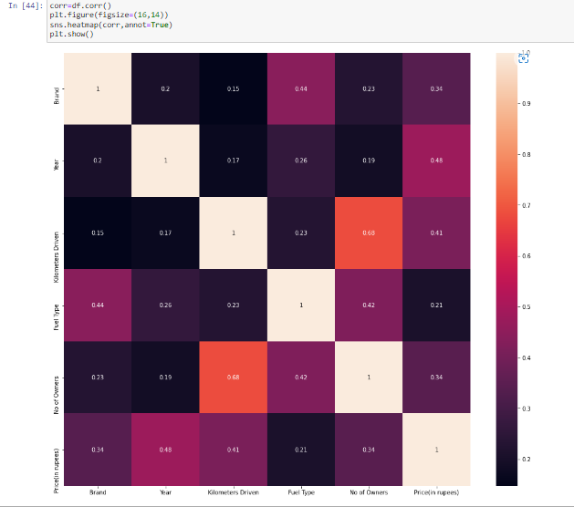
Correlation using Heatmap

Slide 16
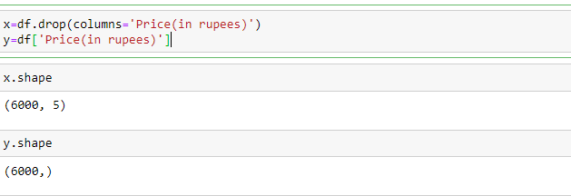
Splitting the data into Feature and Target

Slide 17
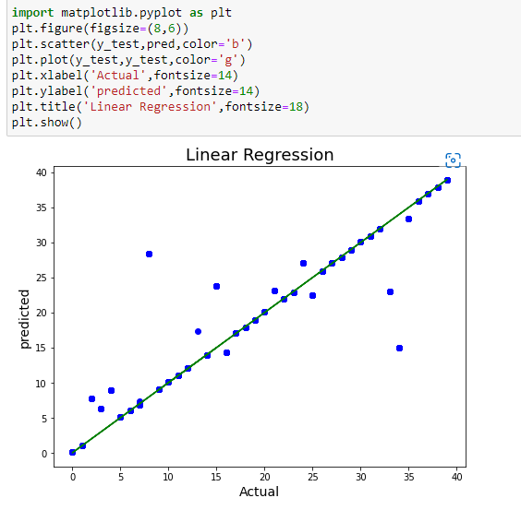
Overfitting & Underfitting

Slide 18
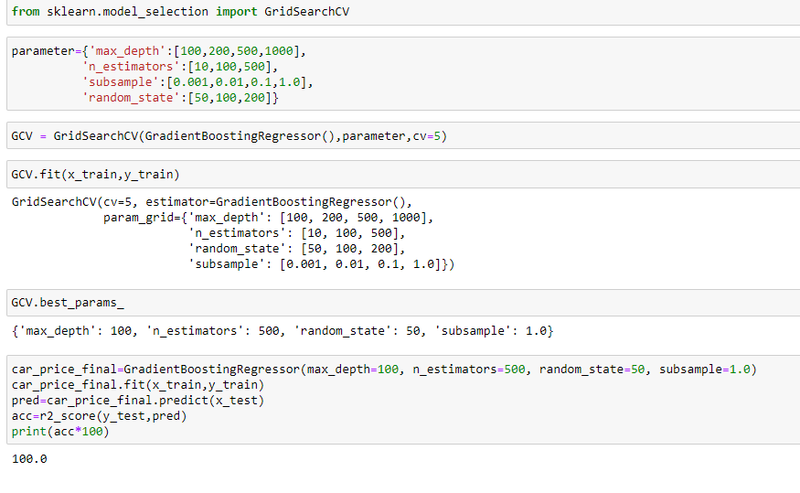
Hyper Parameter Tuning

Slide 19
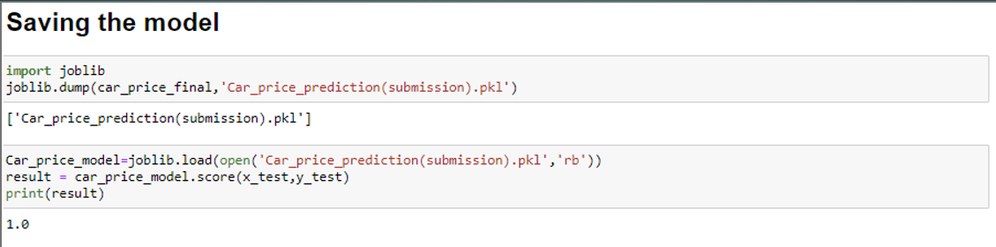
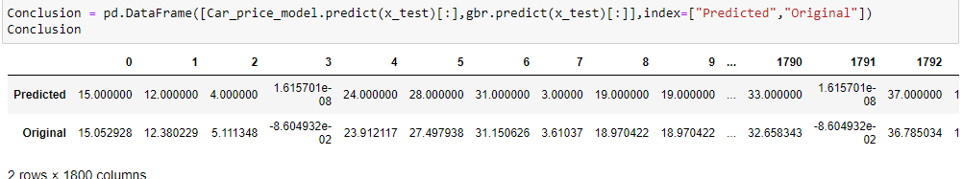
Conclusion

Slide 20
Conclusion
So, the conclusion is the average selling price and average present price of the cars are not the same they are different. Regression: Regression analysis consists of a set of machine learning methods that allow us to predict a continuous outcome variable (y) based on the value of one or multiple predictor variables (x).

Slide 21
Thank You

